Slide 1
University of Diyala College of Engineering Dept. of Communications

Slide 2
“ Digital Communications “ By Haidar N. Al-Anbagi Lec (6) Time: (4 hrs) 2017

Slide 3
PCM transmission bandwidth
As we discussed in the previous lecture, each quantization level gets a unique binary code which contains n binary digits. Recalling the relationship between the number of quantization levels (L) and the number of binary digits required to represent each quantization level uniquely,
L=$2^{n}$ or n = log₂ L (1)
.

Slide 4
Now, since our message signal is band limited signal to B Hz, we require a minimum of 2B samples per second as a sampling rate, according to the sampling theorem we discussed before. Therefore, the total bit per second required is 2nB bits per second (bps).

Slide 5
What is the relationship between bit rate and the transmission bandwidth?
One of the most fundamental relationships in communications is that “we can transmit maximum of 2B pieces of information per second error free over a noiseless channel of a bandwidth ${ B}_{T}$ is given by,
${ B}_{T}=nB Hz$

Slide 6
Example:
A signal m(t), which is band limited to 3 KHz, is sampled at a rate
33.33 % higher than the Nyquist rate. The maximum quantization error is 0.5% of
the peak amplitude mp. (1) If the quantization levels are binary coded, find the
minimum transmission bandwidth required to transmit the encoded binary signal.
(2) If we time multiplex 24 such signals, what would be the total transmission
bandwidth required to transmit the time multiplexed signal?
Solution: First, we should calculate the Nyquist rate,
RN=2 fm=2*3000=6000 Hz (samples per second)
Since the signal m(t) is sampled at a rate 33.33% higher than the Nyquist rate, the actual sampling rate is
R=6000+6000*13=8000 Hz (samples per second)
Next is the maximum quantization error which can be calculated as follows:
Max error = ± ∆v2 where ∆v is the quantization step size
Note: L must be a power of 2; for example, 4, 8, 16, 32…
The next higher L values which satisfies the condition above is 256.

Slide 7
The number of bits required to represent each quantization level uniquely is
n = log₂ L = log₂ 256 = 8 bits per sample.
Now, the data rate as it is given in the example is 8000 samples/s, therefore, we need to transmit total of 8000*8 = 64000 bits/s.
Because we may only transmit 2 bits/s per one hertz, we need
64000/2= 32000 = 32 KHz of BW.
What would be the transmission bandwidth if we time multiplex 24 such signals?
If we do time multiplexing, the total bit/s is
24*64000 = 1.536 M bits/s and that amount needs
1.536 M /2 = 0.768 MHz of BW.

Slide 8
Historical Note:
The first mathematician who worked on binary representation of data is Goltfried Wilhem Leibnitz (1646- 1716). He believed that 1 represents unity which is a symbol of God and 0 represents the nothingness. Therefore, representing data using 0 and 1 proves that God has created the universe out of nothing!

Slide 9
Output SNR:
During the quantization process of PCM, the range (-${ m}_{p} , { m}_{p}$) is divided into L zones which are equally spaced by $∆$ where,
$∆=$ $\frac{2 { m}_{p}}{L}$ (3)
Each sample is approximated to the closest quantization level and finally each quantization level is binary coded. These codes are sent as binary pulses to their desired destination. At that destination, some of those samples are detected incorrectly. Therefore, two sources of errors, quantization errors and pulse code detection errors. Pulse detection error is so small compared to the quantization error and for that reason, we can ignore it. Then,
Figure 8 Shows non uniform quantization

Slide 10
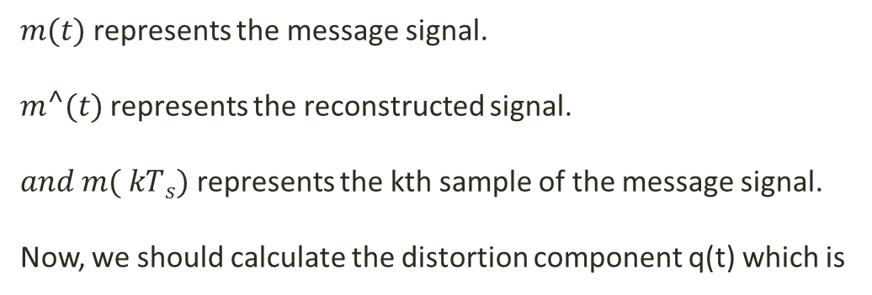

Binary encoding
$m(t)=\sum_{k}{m\left({ kT}_{s}\right)}sinc(2πBt−kπ)$ (4)
And, $m⌃(t)=\sum_{k}{m⌃\left({ kT}_{s}\right)}sinc(2πBt−kπ$ (5)
where,
$m(t)$ represents the message signal.
$m⌃(t)$ represents the reconstructed signal.
$and m({ kT}_{s})$ represents the kth sample of the message signal.
Now, we should calculate the distortion component q(t) which is

Slide 11
$q(t)=\sum_{k}{[m⌃\left({ kT}_{s}\right)−m\left({ kT}_{s}\right)]}sinc(2πBt−kπ$ (6)
$q(t)=\sum_{k}{q\left({ kT}_{s}\right)}sinc(2πBt−kπ)\text{ (}\text{7}\text{)}$
$\text{Where}\text{, }$
$\text{q}\text{(}\text{t}\text{) = }\text{Unwanted} \text{signal}\text{ (}\text{i}\text{.}\text{e}\text{. }\text{noise} \text{signal}\text{) }\text{caused} \text{by} \text{the} \text{quantizer}\text{. }$
$\text{Hence}\text{, }\text{it} \text{is} \text{called} \text{quantization} \text{noise}\text{. }$
$\text{To} \text{get} \text{the} \text{power} \text{of} \text{the} \text{quantization} \text{noise}\text{, }\text{we} \text{apply}\text{:}$
$\underset{T→∞}{q^{2}(t)=lim}{1/T}\int_{−T/2}^{T/2}{q^{2}(t)} dt \text{(}\text{8}\text{)}$
$\text{ = }\lim_{T→∞}{1/T}\int_{−T/2}^{T/2}{{[\sum_{k}{q\left({ kT}_{s}\right)}sinc(2πBt−kπ)]}^{2}} dt \text{(}\text{9}\text{)}$

Slide 12
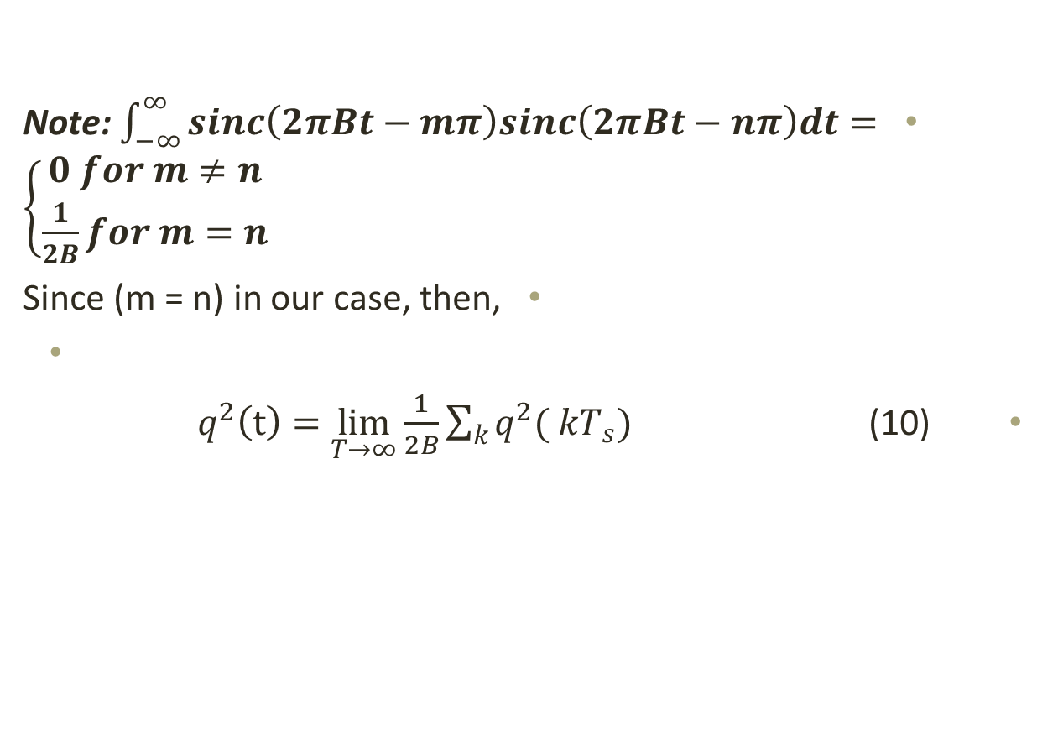
Note: $\int_{−∞}^{∞}{sinc\left(2πBt−mπ\right)sinc\left(2πBt−nπ\right)dt=}$ $\left\{\begin{aligned}0 for m≠n \\ \frac{1}{2B}for m=n\end{aligned}\right.$
Since (m = n) in our case, then,
$q^{2}\left(t\right)=\lim_{T→∞}{\frac{1}{2B}\sum_{k}{q^{2}({ kT}_{s})}}$ (10)

Slide 13
Since 2B represents the sampling rate and T represents the total interval, the right side of equation (10) represents the average of the square of the quantization error.
The quantization step size is
$∆v=$ $\frac{2 { m}_{p}}{L}$ then, the mean square quantization error is given by
$q^{2}$= 1/$∆v$ $\int_{−∆v/2}^{∆v/2}{q^{2}} dq$ = ${∆v}^{2}$/12 = ${{ m}_{p}}^{2}/3L^{2}$ (11)
Finally, the reconstructed signal at the receiver side will be
$m⌃\left(t\right)= m\left(t\right)$ + $q(t)$ (12)
For the purpose of S/N calculations, we can use the following equations:
${ S}_{0}= m^{2}\left(t\right)$ which is the power of the message signal
${ N}_{0}= { N}_{q}=$ $\frac{{{ m}_{p}}^{2}}{3L^{2}}$which is the power of the quantization noise
Therefore, $\frac{{ S}_{0}}{{ N}_{0}}=3L^{2}$ $\frac{m^{2}\left(t\right)}{{{ m}_{p}}^{2}}$ (13)

